Slide 1

Self Organizing Map
Data Mining
Instructor: Dr. Roozbeh Razavi Far
Winter – 2019
Student Name:
Siddhartha Tamal Taru (105017813)
Vedant Dave (105101020)

Slide 2

Introduction
A huge number of data gathered every day,
But, all are not complete
Further processes and analysis is required on enormous “Raw Data”
Finding missing data & data patterns are required
Such field known as “ Data Mining”

Slide 3

objectives
Manage the “categorical” and “numerical data” with MATLAB programing
Find out the missing data using Self Organizing Map
Analyze the final output data to check the accuracy and effectiveness of “SOM”
tune the parameter of algorithm to achieve NRMS =0.1 and AE < 1.

Slide 4
self organizing map (som)
Self-organizing map method of clustering problems is popular in the financial organizations where massive data is used.
Self-organizing map works as nonparametric regression and it can work with datasets having several variables.
SOM is widely used in cluster analysis for the neural network methods.
SOM especially uses points from its low dimensional space to illustrate its high dimensional sources, both in 2d or 3d models.

Slide 5
Four Major components of SOM
Initializing the connection weights from a random dataset.
For each data pattern, there will be computation of respective values for finding out the discriminant function, which is known as competition process among the dataset. Specially data who has smallest discriminant function value are chosen as wining value.
The winning data will determine the topological neighborhood which is known as cooperation among the datasets.
Topological neighboring does not only update the weights for winning data, it other members of neighborhood will also get chance of weight update by adaptation process among the neighborhood.
Ref: [1]

Slide 6
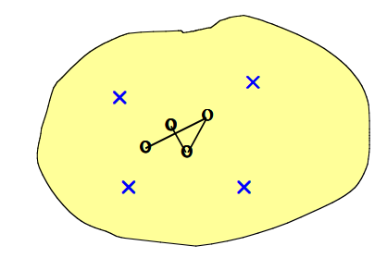
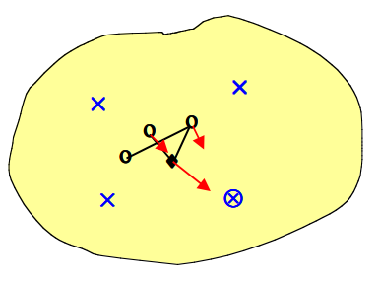

Visualization of Self Organizing Map
Fig:1 [1]
Take four Data point(cross) in 2D and put their output as 1D(dot)
Fig:2 [1]
Take one Data point under training, and move the closest output towards it.

Slide 7
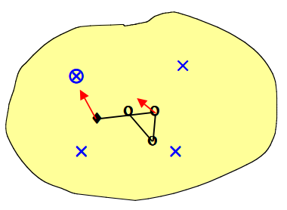
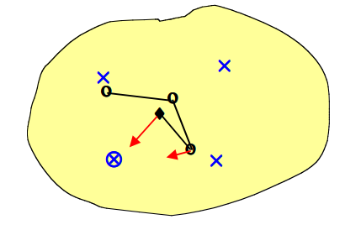
Visualization of Self Organizing Map
Fig : 3 [1]
Take second Data point under training, and move the closest output towards it.
Fig:4 [1]
Take fourth Data point under training, and move the closest output towards it.

Slide 8
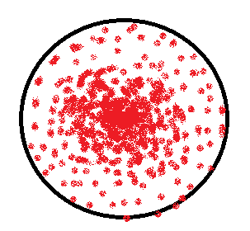
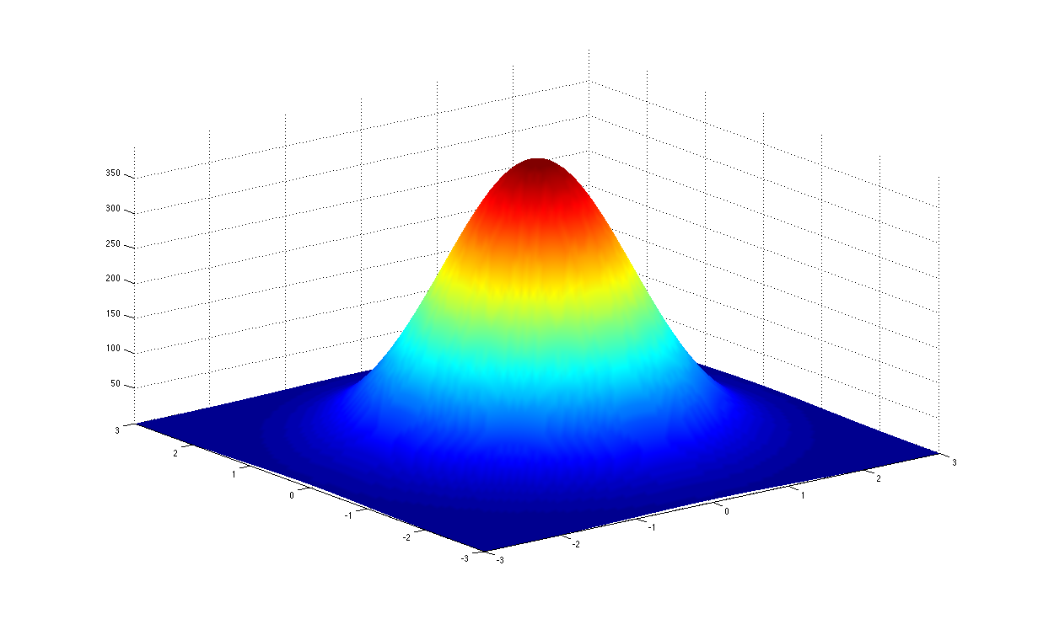
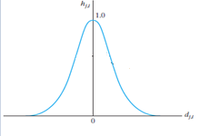
Clustering
When there will be a large number of data, those data can be grouped according to similar characteristics for quantitative analysis, that is called clustering
Clustering of Data
Fig 5 - Top view
Fig 6 :3-D view
Fig 7 : 2-D view [1]

Slide 9
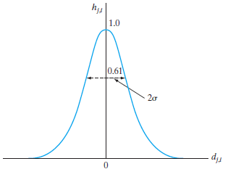



Process of making Clustering
Cooperative Process
Parameters:
(1) Lateral distance between the i and j. (Dj,i)
(2) the topological neighborhood hj, I
Fig 8 : Plotting of Gaussian neighborhood function [1]

Slide 10
How SOM work to find missing data
Given missing data (x) Training data set (x’)
Step 1
We need to use the valid components and remove all missing data for finding mean weight.
Step 2
Use the weights of each data to estimate the missing components of the corresponding input observation Ref : [2]

Slide 11
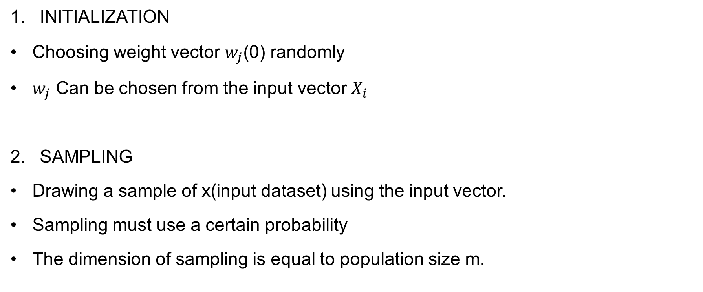
Algorithm
Initialization
Choosing weight vector $w_{j}$(0) randomly
$w_{j}$ Can be chosen from the input vector $X_{i}$
Sampling
Drawing a sample of x(input dataset) using the input vector.
Sampling must use a certain probability
The dimension of sampling is equal to population size m.

Slide 12


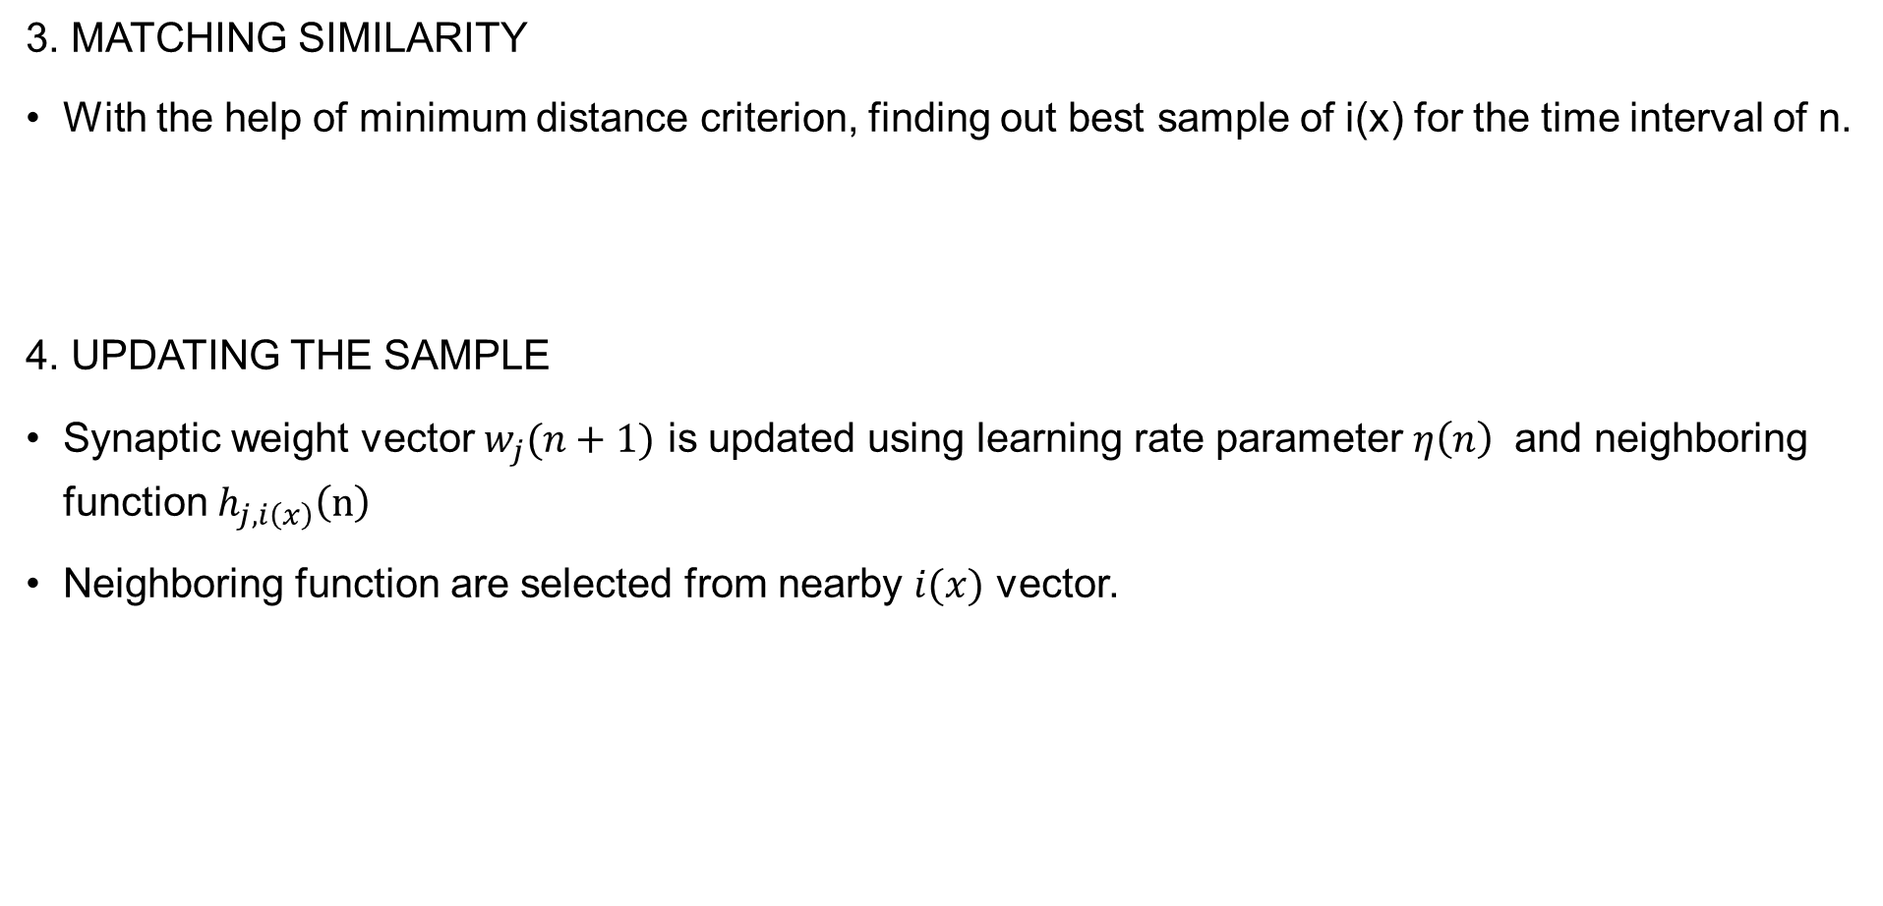
Algorithm
3. Matching Similarity
With the help of minimum distance criterion, finding out best sample of i(x) for the time interval of n.
4. Updating the sample
Synaptic weight vector $w_{j}(n+1)$ is updated using learning rate parameter $η\left(n\right)$ and neighboring function $h_{j,i\left(x\right)}\left(n\right)$
Neighboring function are selected from nearby $ⅈ(x)$ vector.

Slide 13
Algorithm
5. Continuation
The process must continue and start from step 2 ( sampling) until step 4 ( updating) until significant changes are observed in feature map.
Ref : [1]

Slide 14
Development/input/output
Development
We will use MATLAB as a software to implement self organizing map algorithm.
Input
Matrix with missing data set containing both numerical and categorical data.
output
Matrix after imputation of missing value.
Analysis of different output.

Slide 15
Computational Complexity
For SOM , computational complexity is linear to total number of data sample .
Complexity is found in training a huge number of data mapped by SOM algorithm.
The number of map unit and number of documents should be proportional for making better resolution .
Ref [3]

Slide 16
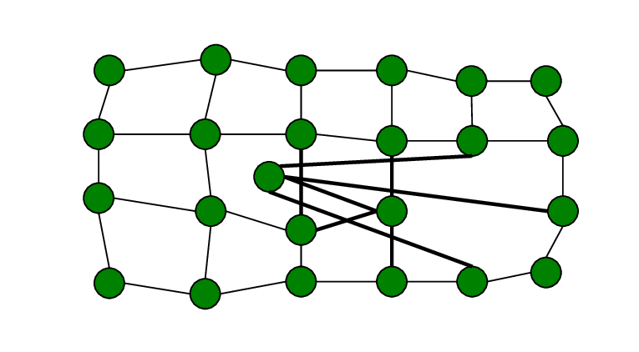
Improvement of the method
The quality of Self organizing map is improve by “Avoidance of Self Intersection” of each data
will give a better quality of map for analysis
Fig : 9 [4]
Improving the self organizing map with the “Efficient Initialization Scheme.”… which save the time and the accuracy of the data set with less amount of time (iteration). [5]
Improving the accuracy of self organizing map by using the “Distance Metric Learning” method.

Slide 17
Advantages
It does not need any supervised learning
It can classify problems in a very effective way
It has less computational complexity
It is highly sensitive for frequent inputs
Limitations
It requires large number of training set
Sometimes it gets unacceptable error rate.
The final result depends on the initial assuming data so the effectiveness and accuracy are poor. (Depending on the change of initial assumption).
When there are too many data then it takes time to find out the distance among them. Ref: [6]

Slide 18
Application
Neural network analysis
Analysis of survey reports
Statistical analysis for missing data imputation
Image processing
Identify the spam email data for security

Slide 19
references
S. Haykin, "Neural Networks and learning machine," in Data Mining ( concepts and Tecchniques), Hamilton , ON, Canada, 1999, pp. Chapter 9 ( 393- 439).
A. S. D. a. J. Vrettaros, "Using the Self-Organizing Map (SOM) Algorithm, as a Prototype E-Content Retrieval Tool," p. 23.
B. A. L. a. G. Mercier, "Self-Organizing maps for processing of data with missing values and outliners," April 2010. [Online]. Available: http://cdn.intechweb.org/pdfs/10469.pdf. [Accessed February 2019].
E. López-Rubio, "ResearchGate," August 2013. [Online]. Available: https://www.researchgate.net/figure/Example-of-self-intersection_fig4_262149778. [Accessed 21 February 2019].
T.-K. L. ,. H.-T. C. Mu-Chun Su, "Improving the Self-Organizing Feature Map Algorithm Using an," Tamkang Journal of Science and Engineering, p. 13, 2002.
I. D. a. S. P. Mike HUang, "Self organizing features map," [Online]. Available: http://pages.cpsc.ucalgary.ca/~jacob/Courses/Winter2000/CPSC533/Slides/05.2.3-SOFM.pdf. [Accessed February 2019].
F. Fessant and S. Midenet, “Self-organising map for data imputation and correction in surveys,” Neural Computing & Applications, vol. 10, pp. 300–310, 2002

Slide 20


